Slide 1
Aircraft Selection for Business Expansion
Natalie Wanjiku

Slide 2
BUSINESS CONTEXT
Your company is expanding in to new industries to diversify its portfolio. Specifically, they are interested in purchasing and operating airplanes for commercial and private enterprises, but do not know anything about the potential risks of aircraft. You are charged with determining which aircraft are the lowest risk for the company to start this new business endeavor. You must then translate your findings into actionable insights that the head of the new aviation division can use to help decide which aircraft to purchase.

Slide 3
DATA PROCESS STEPS
Defining the Question
Importing the required Libraries
Importing the Data
Tidying the Data
Data Analysis
Data Visualization

Slide 4
RESULTS

Slide 5
No of Accidents Recorded
This shows the number of accidents recorded between to 2023. There was a sharp increase in accidents from 1980 to 1990 and a steady reduction from then to 2020.
See the following chart:

Slide 6
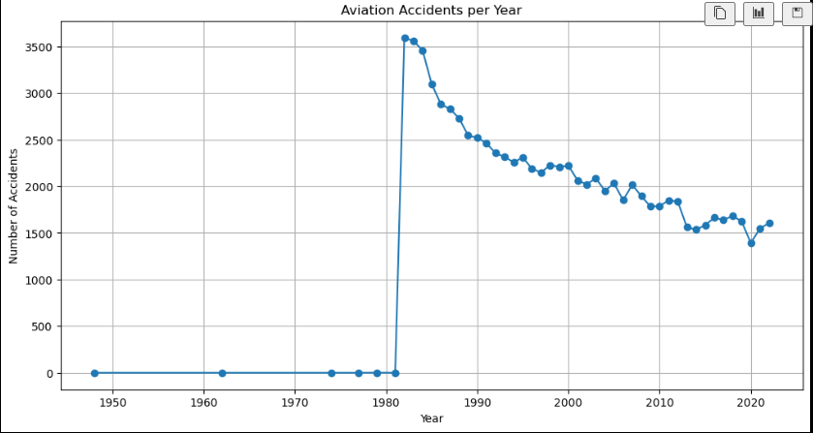
No. of Aviation Accidents Recorded

Slide 7
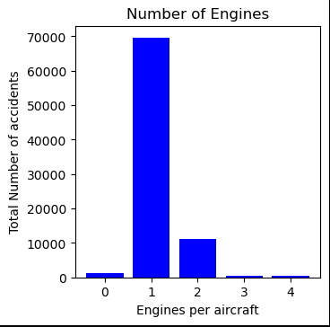
Number of Accidents per No of Engines: The aircrafts with 1No engine were prone to the most accidents as shown below:

Slide 8
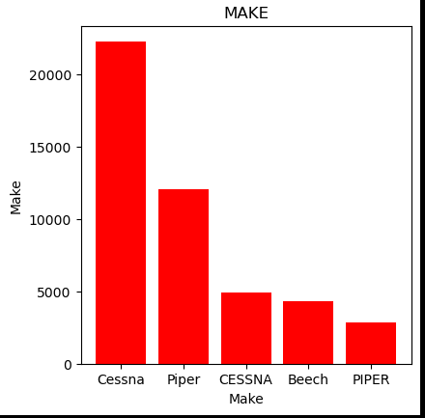
Number of Accidents per Make: The Cessna Aircraft contributed to most of the accidents.

Slide 9
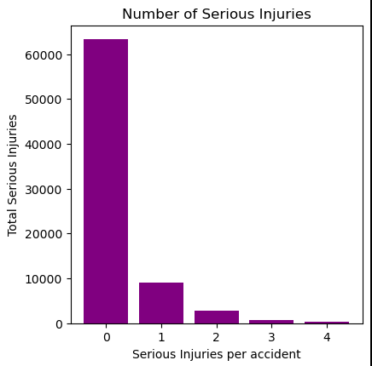
Number of Serious Injuries The data shows that aircraft accidents resulted in very serious injuries

Slide 10
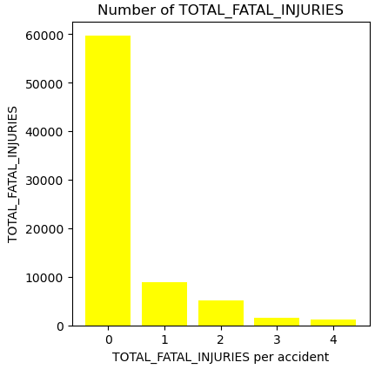
Total Fatal Injuries per Accident The data shows that aircraft accidents resulted in very serious fatalities

Slide 11
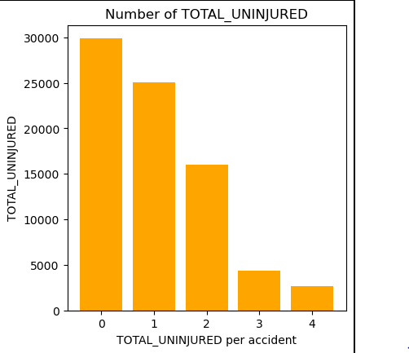
Total No of Uninjured per Accident The data shows that aircraft accidents resulted in very high total number of total injured passengers

Slide 12
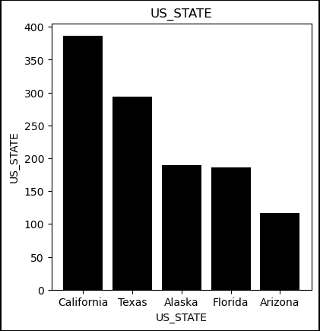
Accidents per State The state of California recorded the highest No of Accidents

Slide 13
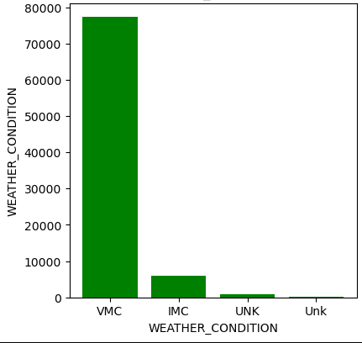
Weather conditions vmc weather condition recorded the highest No of accidents

Slide 14
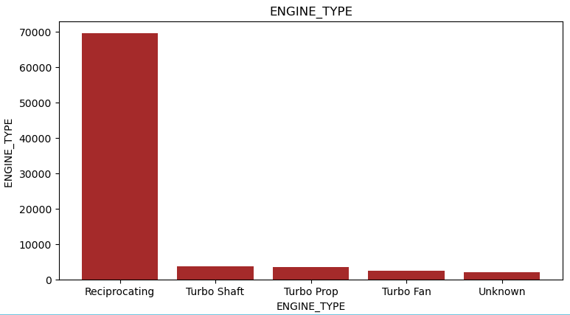
Engine Type The reciprocating engine shows more accidents

Slide 15
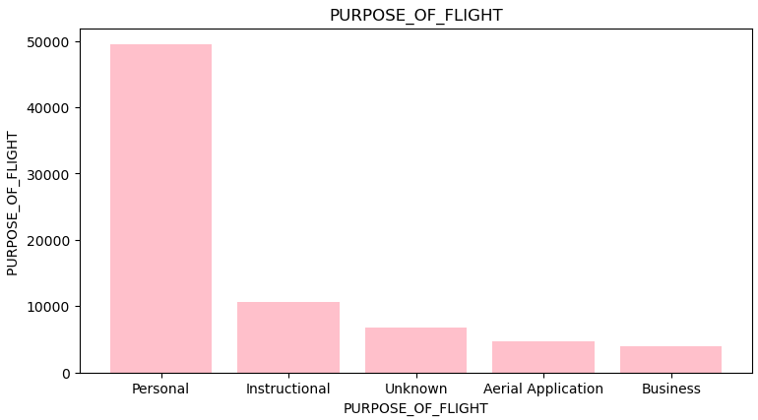
Reason of flight The personal flights show more damage

Slide 16
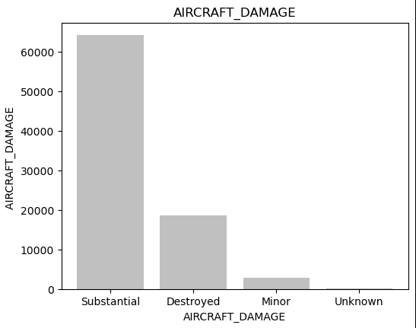
Aircraft Damage The aircrafts show substantial damage when accidents occur

Slide 17
RECOMMENDATION
The Company should avoid the CESSNA aircraft model with 1No engine as well reciprocating engines as they were observed to have the highest number of accidents.

Slide 18
FUTURE IMPROVEMENTS
Based on the available data, single-engine aircraft appear to handle bad weather better, possibly because we have more information about them. To understand how multi-engine aircraft perform in similar conditions, we need more data. It would also be helpful to investigate the specific situations where larger engine aircraft are used.
However, the current data on aviation accidents has already given us valuable insights for suggesting low-risk aviation ventures.

